Slide 1


Live your Why
ACSSJ Student Leadership Webinar Series in the Spirit of the Founders
Notes:
After hearing incredible stories from our CSJs, we begin to wonder what our why is and how we can ensure that we are living a purposeful life, these thoughts of not knowing can weigh us down and keep us from feeling excited and motivated… This is why it’s important to Start with Why. To remind ourselves of why we do what we do, as both individuals here at the Mount in our various positions.
Today you will get to explore why Starting with Why is so critical to our success personally and professionally! To do this we will explore a bit about Simon Sinek’s work on this topic.
Background on Simon Sinek (sih-nek)
A trained ethnographer – scientific study of peoples and cultures, Sinek is fascinated by the leaders and companies that make the greatest impact in their organizations and in the world, those with the capacity to inspire, he has discovered some remarkable patterns about how they think, act and communicate and the environments in which people operate at their natural best. He has devoted his life to sharing his thinking in order to help other leaders and organizations inspire action.
Simon is also best known for popularizing the concept of Why in his first Ted Talk in 2009. It has since risen to the third most watched talk of all time on TED.com, gathering 27+million views and is subtitled in 43 languages.
Sinek says that having a job we love and enjoy and feel good about every day is a right for all, not a privilege – we all want that for ourselves but also for our students – how do we help them get there?

Slide 2
Live your Why
ACSSJ Student Leadership Webinar Series in the Spirit of the Founders
Notes:
After hearing incredible stories from our CSJs, we begin to wonder what our why is and how we can ensure that we are living a purposeful life, these thoughts of not knowing can weigh us down and keep us from feeling excited and motivated… This is why it’s important to Start with Why. To remind ourselves of why we do what we do, as both individuals here at the Mount in our various positions.
Today you will get to explore why Starting with Why is so critical to our success personally and professionally! To do this we will explore a bit about Simon Sinek’s work on this topic.
Background on Simon Sinek (sih-nek)
A trained ethnographer – scientific study of peoples and cultures, Sinek is fascinated by the leaders and companies that make the greatest impact in their organizations and in the world, those with the capacity to inspire, he has discovered some remarkable patterns about how they think, act and communicate and the environments in which people operate at their natural best. He has devoted his life to sharing his thinking in order to help other leaders and organizations inspire action.
Simon is also best known for popularizing the concept of Why in his first Ted Talk in 2009. It has since risen to the third most watched talk of all time on TED.com, gathering 27+million views and is subtitled in 43 languages.
Sinek says that having a job we love and enjoy and feel good about every day is a right for all, not a privilege – we all want that for ourselves but also for our students – how do we help them get there?

Slide 3
How Great Leaders Inspire Action
Simon Sinek Ted Talk

Slide 4
Notes:
Quick Reactions in Tables– 2 minutes
This is the reason we can say that people don’t buy What you do, they buy Why you do it and
What you do simply serves as the tangible proof of what you believe.

Slide 5
YOUR “WHY”
STATEMENT
One sentence that captures your unique contribution and impact
Contribution: Actionable part of your Why
Impact: Condition you wish to leave the people and world around you
Notes:
Individual Why Statement – 5 minutes
The Golden Circle
WHAT
Every person on the planet knows What they do.
This is your job title, function, the products you sell or services you offer.
HOW
Some people know How
they do it.
These are the things you do that make you special or set you apart from your peers.
WHY
Very few people know WHY they do what they do.
The Why is not about making money - that’s a result. The Why is a purpose, cause or belief.
Your Why is the very reason you exist.
YOUR WHY:
Your Why provides you with clarity, meaning and direction. It is a filter through which you can make decisions, every day, to bring your cause to life. A Why Statement is one sentence that captures your unique contribution and impact. The contribution is the real actionable part of your Why. The impact is the condition you wish to leave the people and world around you. Together, these two components provide fulfillment for you and those you serve.
Worksheet - Write down and share with people at your table

Slide 6
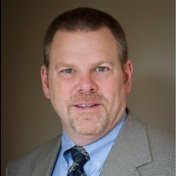
“The Purposeful Graduate: Why Colleges Must Talk to Students about Vocation”
Author: Dr. Tim Clydesdale
Tim Clydesdale is professor of sociology at The College of New Jersey. A first-generation college graduate, he earned his baccalaureate degree at Wheaton College (IL), and completed his PhD at Princeton University. His book which includes research from his evaluation of an 88-campus, Lilly Endowment initiative, was published in May 2015 by the University of Chicago Press.
Notes:
Purpose guides our personal, educational, and career goals but how do we discover our calling or know that we are leading lives of service? There are more questions and steps to take to figure this out but know that you know to start with why, you have the tool to help you figure out if you stay grounded in purpose. The work does not end here, continue to explore how you are using your purpose in your work, involvements, courses and reflect on when you are not being guided by purpose. Remember that most people or organizations operate out of the What or are focused on the How, we empower you to ask Why for the organizations that you are a part of. Know that you know your Why, this could help serve as a filter for making decisions.

Slide 7
Notes:
Why is it that some leaders and organizations are able to inspire greater loyalty and engagement among their
customers and employees alike? How are they are able to achieve and sustain inordinate amounts of success for years on end?
Whether they realize it or not, all great and inspiring leaders and organizations think, act and communicate in the same way... and it is the complete opposite from everyone else.
What we do, How we do it, Why we do it
For The Golden Circle to work properly, you must have:
1. Clarity of Why,
2. Discipline of How, and
3. Consistency of What.
No one section of The Golden Circle is more important than the other. The most important thing is a balance across all three.
WHY:
If you don’t know Why you do What you do, how can you expect anyone else to know? For others to know your Why, you must first have clarity of your own Why.
HOW:
The actions that you and your people take to bring your cause to life must be aligned with your values, guiding principles, strengths and beliefs.
WHAT:
And everything you say and everything you do must be consistent with what you believe. After all, we live in the tangible world. The only way people will know what you believe is if you say and do the things you actually believe.

Slide 8
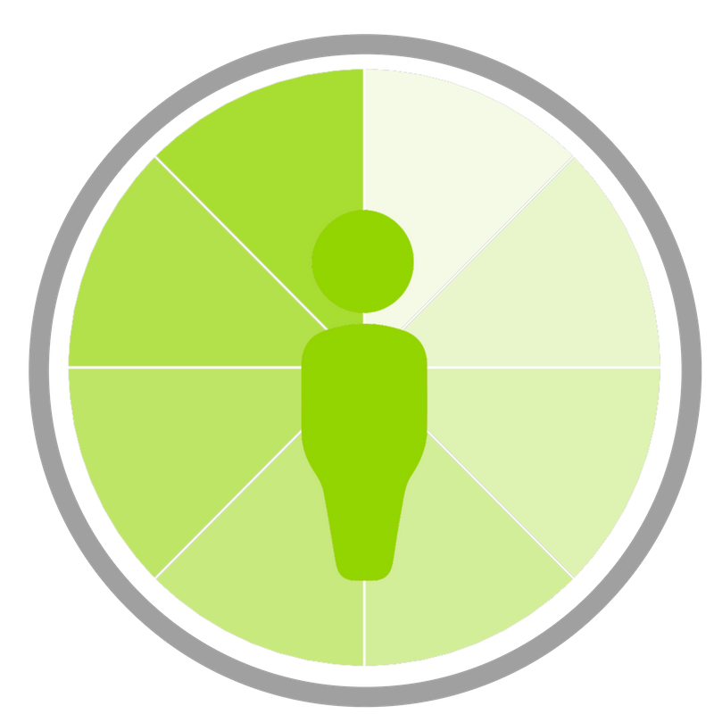

Connections as leaders at the Mount
SA Learning Dimensions
Students as Leaders
Students as Learners
Students of Conscience
To learn more visit www.startwithwhy.com
and www.msmu.edu/CalledtoLead

Slide 9
Consensus Statement of the Sisters of St. Joseph
Stimulated by the Holy Spirit of Love
and receptive to these inspirations
The Sister of Saint Joseph moves always
towards profound love of God
and love of neighbor without distinction
from whom she does not separate herself
and for whom, in the following of Christ
she works in order to achieve unity
both of neighbor with neighbor
and neighbor with God
directly in this apostolate and indirectly through works of charity,
in humility – the spirit of the Incarnate Word (Phil 2:5-11)
in sincere charity – the manner of Saint Joseph,
whose name she bears
in an Ignatian-Salesian climate:
that is, with an orientation towards excellence,
tempered by gentleness, peace, joy.
Notes:
Why is it that some leaders and organizations are able to inspire greater loyalty and engagement among their
customers and employees alike? How are they are able to achieve and sustain inordinate amounts of success for years on end?
Whether they realize it or not, all great and inspiring leaders and organizations think, act and communicate in the same way... and it is the complete opposite from everyone else.
What we do, How we do it, Why we do it
For The Golden Circle to work properly, you must have:
1. Clarity of Why,
2. Discipline of How, and
3. Consistency of What.
No one section of The Golden Circle is more important than the other. The most important thing is a balance across all three.
WHY:
If you don’t know Why you do What you do, how can you expect anyone else to know? For others to know your Why, you must first have clarity of your own Why.
HOW:
The actions that you and your people take to bring your cause to life must be aligned with your values, guiding principles, strengths and beliefs.
WHAT:
And everything you say and everything you do must be consistent with what you believe. After all, we live in the tangible world. The only way people will know what you believe is if you say and do the things you actually believe.

Slide 10

MISSION OF THE SISTERS OF ST. JOSEPH
To continue the ministry of Jesus:
“That all may be
ONE.”
John 17:21
CHARISM
Unifying Love
US Federation of Sisters of Saint Joseph
Notes:
Why is it that some leaders and organizations are able to inspire greater loyalty and engagement among their
customers and employees alike? How are they are able to achieve and sustain inordinate amounts of success for years on end?
Whether they realize it or not, all great and inspiring leaders and organizations think, act and communicate in the same way... and it is the complete opposite from everyone else.
What we do, How we do it, Why we do it
For The Golden Circle to work properly, you must have:
1. Clarity of Why,
2. Discipline of How, and
3. Consistency of What.
No one section of The Golden Circle is more important than the other. The most important thing is a balance across all three.
WHY:
If you don’t know Why you do What you do, how can you expect anyone else to know? For others to know your Why, you must first have clarity of your own Why.
HOW:
The actions that you and your people take to bring your cause to life must be aligned with your values, guiding principles, strengths and beliefs.
WHAT:
And everything you say and everything you do must be consistent with what you believe. After all, we live in the tangible world. The only way people will know what you believe is if you say and do the things you actually believe.

Slide 11

Moving always toward profound love of God & love of neighbor without distinction
Notes:
Leadership
Why is it that some leaders and organizations are able to inspire greater loyalty and engagement among their
customers and employees alike? How are they are able to achieve and sustain inordinate amounts of success for years on end?
Whether they realize it or not, all great and inspiring leaders and organizations think, act and communicate in the same way... and it is the complete opposite from everyone else.
What we do, How we do it, Why we do it
For The Golden Circle to work properly, you must have:
1. Clarity of Why,
2. Discipline of How, and
3. Consistency of What.
No one section of The Golden Circle is more important than the other. The most important thing is a balance across all three.
WHY:
If you don’t know Why you do What you do, how can you expect anyone else to know? For others to know your Why, you must first have clarity of your own Why.
HOW:
The actions that you and your people take to bring your cause to life must be aligned with your values, guiding principles, strengths and beliefs.
WHAT:
And everything you say and everything you do must be consistent with what you believe. After all, we live in the tangible world. The only way people will know what you believe is if you say and do the things you actually believe.

